Slide 1
Context
Web Fundamentals
Walking An Application
Exploring The Website:
Viewing The Page Source
Developer Tools – Inspector
Developer Tools – Debugger
Developer Tools - Network

Slide 2
Walking An Application

Slide 3
In this room you will learn how to manually review a web application for security issues using only the in-built tools in your browser. More often than not, automated security tools and scripts will miss many potential vulnerabilities and useful information
Here is a short breakdown of the in-built browser tools you will use throughout this room:
View Source - Use your browser to view the human-readable source code of a website.
Inspector - Learn how to inspect page elements and make changes to view usually blocked content.
Debugger - Inspect and control the flow of a page's JavaScript
Network - See all the network requests a page makes.

Slide 4
Exploring The Website:
As a penetration tester, your role when reviewing a website or web application is to discover features that could potentially be vulnerable and attempt to exploit them to assess whether or not they are. These features are usually parts of the website that require some interactivity with the user.
Viewing The Page Source:
The page source is the human-readable code returned to our browser/client from the web server each time we make a request. The returned code is made up of HTML ( HyperText Markup Language), CSS ( Cascading Style Sheets ) and JavaScript, and it's what tells our browser what content to display, how to show it and adds an element of interactivity with JavaScript.
Tool: gobuster,dirsearch,dirb
Developer Tools – Inspector:
We're specifically focusing on three features of the developer tool kit, Inspector, Debugger and Network.

Slide 5
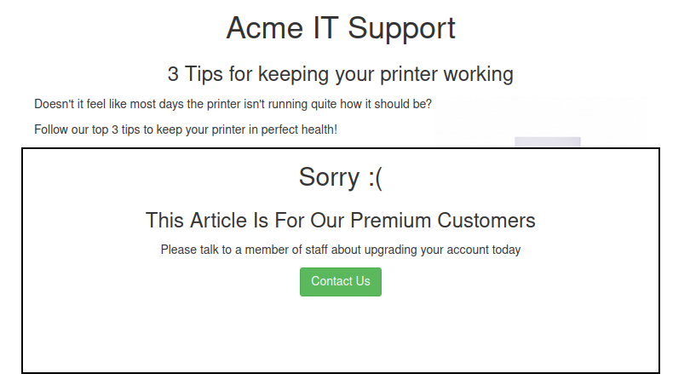
Inspector: The page source doesn't always represent what's shown on a webpage; this is because CSS, JavaScript and user interaction can change the content and style of the page, which means we need a way to view what's been displayed in the browser window at this exact time. Element inspector assists us with this by providing us with a live representation of what is currently on the website.
Acme IT Support website, The first two articles are readable, but the third has been blocked with a floating notice above the content stating you have to be a premium customer to view the article

Slide 6
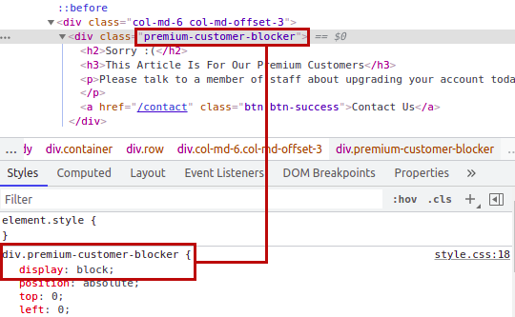
Right-clicking on the premium notice ( paywall ), you should be able to select the Inspect option from the menu, which opens the developer tools either on the bottom or right-hand side depending on your browser or preferences. You'll now see the elements/HTML that make up the website ( similar to the screenshots below ).
Try typing none, and this will make the box disappear, revealing the content underneath it and a flag. If the element didn't have a display field, you could click below the last style and add in your own. Have a play with the element inspector, and you'll see you can change any of the information on the website, including the content. Remember this is only edited on your browser window, and when you press refresh, everything will be back to normal.

Slide 7
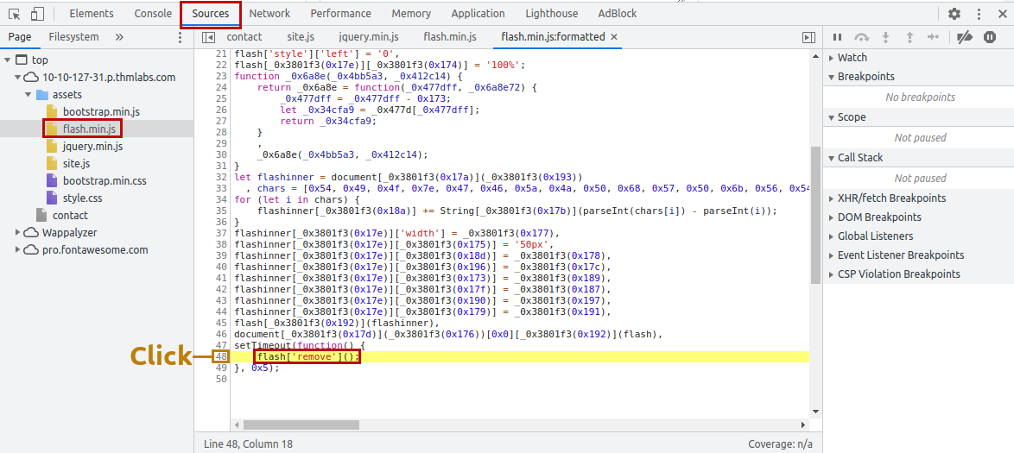
Developer Tools – Debugger:
This panel in the developer tools is intended for debugging JavaScript, and again is an excellent feature for web developers wanting to work out why something might not be working. But as penetration testers, it gives us the option of digging deep into the JavaScript code. In Firefox and Safari, this feature is called Debugger, but in Google Chrome, it's called Sources.
In both browsers, on the left-hand side, you see a list of all the resources the current webpage is using. If you click into the assets folder, you'll see a file named flash.min.js. Clicking on this file displays the contents of the JavaScript file.

Slide 8
This little bit of JavaScript is what is removing the red popup from the page. We can utilise another feature of debugger called breakpoints. These are points in the code that we can force the browser to stop processing the JavaScript and pause the current execution. If you click the line number that contains the above code, you'll notice it turns blue; you've now inserted a breakpoint on this line
Developer Tools – Network:
The network tab on the developer tools can be used to keep track of every external request a webpage makes. If you click on the Network tab and then refresh the page, you'll see all the files the page is requesting. AJAX is a method for sending and receiving network data in a web application background without interfering by changing the current web page.

